Slide 1
Synchronization Categories
3 categories in which synchronization applies:
Human/Machine
Machine/Machine
Human/Human

Slide 2

Sensor drift measurement
Hardware oscillators measured in parts-per-million (ppm).
Oscillator accuracy directly affects system time.
Varies from $±20ppm$ (crystals) to $±5000ppm$ (digitally controlled oscillators)
System drift can be calculated using ppm.
Ground truth drift can be calculated between two times $t_{i}$ and $t_{j}$ by:
$$d_{i,j}=\frac{ppm⋅\left(\left|t_{i}−t_{j}\right|\right)}{1,000,000}$$
Ex.: After 60 seconds, a $±5000ppm$ clock will have drifted by approx. 0.3 seconds.
True onset of event:
$ω_{i}+d_{0j}$
where $ω_{i}$ is the onset time of the event and $d_{0w_{i}}$ is the drift from the beginning to the onset.

Slide 3

Data collection
System clocks tend to be inaccurate.
Use crystal oscillations.
Build data collection instrument (DCI).
Invensense MPU9150 (200 Hz, $±5000ppm$ DCO)
MSP430 or ATMega138 MCU ($±20ppm$)
Human/Machine
Use ardu-keyboard constructed during extremis project.
Arduino has 16MHz clock with $±20ppm$.
Synchronize with DCI.
Machine/Machine
DCI with parallax robot (camera, instrumentation, etc.)
Human/Human
DCI with DCI.

Slide 4

Pairwise Synchronization
Given two nodes $i$ and $j$, estimate the offset $O_{ij}$ and skew $α_{ij}$ of each node$j$ relative to node $i$ (the reference node)
Offset describes the difference between a sensor’s clock and the reference clock.
Skew describes the speed of a sensor’s clock with respect to the reference clock.

Slide 5

Skew estimation
Assume differences between oscillators is linear.
$T_{i}=α_{i}t+O_{ij}$ <- Time at node $i$
We must estimate $α_{i}$and $O_{ij}$
First, estimate ${\hat{α}}_{ij}$
Drift calculated as $d_{ij}= |T_{j}−T_{i}|$
Assume event occurs at $e\left(t_{k}\right)$
$X\left(t_{k}\right)$ denotes timestamp when node $i$ experiences $e\left(t_{k}\right)$.
$Y\left(t_{k}\right)$ denotes timestamp when node $j$ experiences $e\left(t_{k}\right)$.
$O_{ij}$ can be estimated using supervised learning and finding the event on both sensors.
${\hat{α}}_{ij}(t_{k})$ can be estimated using regression.
Recursive least squares used in literature.
$${\hat{α}}_{ij}\left(t_{k}\right)=argmin_{α} \sum_{l=0}^{k−l}{λ^{k−l}} {\left[Y\left(t_{l+1}\right)−Y\left(t_{l}\right)−α\left[X\left(t_{l+1}\right) −X\left(t_{l}\right)\right]\right]}^{2}$$
Notes:
Time $Y\left(t_{k}\right)$should have experienced $e(t_{k})$ can be estimated using $N$ values of $X\left(t_{k}\right)$ and $Y\left(t_{k}\right)$
$$\hat{Y}\left(t_{k}\right)=\frac{1}{N}\sum_{l=k−1}^{k−1}{[Y\left(t_{l}\right)+{\overline{α}}_{ij}\left(t_{k}\right)\left(X\left(t_{k}\right)−X\left(t_{l}\right)\right)]}$$
We can then determine $O_{ij}\left(t_{k}\right)= \hat{Y}\left(t_{k}\right) −X\left(t_{k}\right)$

Slide 6

Offset estimation
Assumptions:
Sensors are “coupled”: sensors being synchronized experienced the same events.
Therefore, # events in node $i$ = # events in node $j$
The reference node is on the correct time.
Detect onset of event $e_{k}$ in nodes $i$ and $j$
${β_{i}}_{k}$ and $β_{j_{k}}$ is the onset of event $e_{k}$ on sensor nodes $i$ and $j$, respectively.
$$O_{ij}=|β_{i_{k}}−β_{j_{k}}|$$
Once offset $O_{ij}$ has been estimated, skew $α_{ij}$ can be estimated.

Slide 7

Synchronization Evaluation
Synchronization accuracy difficult to assess directly.
Assess accuracy using total drift reduction with our method vs. no method applied.
Let sensor $j$ be the reference node.
Let $d_{{ij}_{R}}$ be drift at sensor $j$ relative to reference node $i$
$d_{ij}= |T_{j}−T_{i}|$
Let $d_{{ij}_{S}}$ be the synchronized drift at sensor $j$ relative to reference node $i$
$${DR}_{ij}\left(\%\right)= \frac{|d_{{ij}_{R}}−d_{{ij}_{S}}|}{d_{ij_{R}}} ×100$$

Slide 8
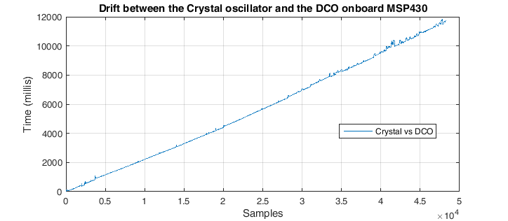
Drift on-board msp430

